Slide 1
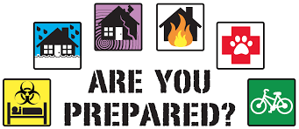
trauma and emergency
Kasiti,S.M

Slide 2
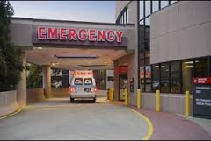
the ambulance is here, what do we have?

Slide 3
objectives
Initiate the management of patients with trauma, and other emergencies.
Participate in the management of patients with trauma, and other emergencies.

Slide 4
types of emergencies
Trauma
Head injury
Severe haemorrhage
Burns and scalds
Poisoning
Some medical emergencies like Anaphylaxis, diabetic coma, cardiac arrest

Slide 5
Management of trauma
The main aim of trauma care is to prevent early trauma mortality.
Early trauma deaths occur because of failure of oxygenation of vital organs or central nervous system injury, or both

Slide 6
Aims of the Initial Evaluation of Trauma Patients
Stabilize the patient
Identify life-threatening conditions in order of risk and initiate supportive treatment
Organize definitive treatments or organize transfer for definitive treatments

Slide 7
Prehospital phase
Co-ordination and communication with the receiving hospital so that the trauma team can be alerted and mobilized.
Airway maintenance.
Control of external bleeding shock
Keeping the patient immobilized.
Information gathering: time of injury; related events; patient history. Key elements are the mechanism of injury to alert the trauma team to the degree and type of injury.
Keeping time at the scene to a minimum.
Co-ordination and communication with the receiving hospital so that the trauma team can be alerted and mobilized.
Airway maintenance.
Control of external bleeding shock
Keeping the patient immobilized.
Information gathering: time of injury; related events; patient history. Key elements are the mechanism of injury to alert the trauma team to the degree and type of injury.
Keeping time at the scene to a minimum.

Slide 8
Hospital phase
Preparation of a resuscitation area.
Airway equipment - laryngoscopes, etc. (accessible, tested).
Intravenous (IV) fluids (warming equipment, etc.).
Immediately available monitoring equipment.
Methods of summoning extra medical help.
Prompt laboratory and radiology backup.
Transfer arrangements with trauma center.

Slide 9
haemorrhage
Assess pulse, capillary return and state of neck veins
Identify exsanguinating hemorrhage and apply direct pressure
Place two large caliber intravenous cannulas
Take venous blood for FBC, U+Es, and Cross match
Take sample for arterial blood gasses
Give intravenous fluids
Crystalloid or colloid in adequate volume
Attach patient to ECG monitor
Insert urinary catheter
Notes:
Two large-bore intravenous lines are established and crystalloid solution may be given. If the person does not respond to this, type-specific blood, or O-negative if this is not available, should be given.

Slide 10
Management of head injuries
Definition of Head Injury
Any trauma to the scalp, skull, or brain
Head trauma includes an alteration in consciousness no matter how brief.
Causes
Motor vehicle accidents
Firearm-related injuries
Falls
Assaults
Sports-related injuries
Recreational accidents

Slide 11
Nursing assessment
GCS score
Neurologic status
Presence of CSF leak

Slide 12
gcs
Eye opening
spontaneous -4
to speech -3
to pain -2
no response -1
Verbal response
oriented -5
confused -4
inappropriate words -3
incomprehensible sounds-2
no response -1

Slide 13
Gcs cont
Motor response
Obeys commands -6
Localizes -5
Withdraws -4
Flexes -3
Extends -2
No response -1
Total score is 3-15
GCS < 8 has generally become accepted as representing coma / severe head injury

Slide 14
mngt
Overall goals:
Maintain adequate cerebral perfusion
Remain normothermic
Be free from pain, discomfort, and infection
Attain maximal cognitive, motor, and sensory function

Slide 15
Clinical indication of inhalation injury
Face and/or neck burns.
Singeing of the eyebrows and around the nose.
Carbon deposits and acute inflammatory changes in the oropharynx.
Carbon particles seen in sputum.
Hoarseness.
History of impaired awareness, eg alcohol or head injury, and/or confinement in a burning environment.
Explosion, with burns to head and torso.
Carboxyhaemoglobin level greater than 10% if the patient is involved in a fire.

Slide 16
Mngt of inhalation injury
Early management may require endotracheal intubation and mechanical ventilation.
Transfer to a burn centre.
Stridor is an indication for immediate endotracheal intubation.
Circumferential burns of the neck may lead to swelling of the tissues around the airway and so require early intubation.

Slide 17
Clinical manifestation of CO poisoning
headache, muscular weakness, palpitation, dizziness, and
confusion,which can progress rapidly to coma.
Skin color, which can range from pink or cherry-red to cyanotic and pale, is not a reliable sign.

Slide 18
CO poisoning
CO poisoning: has a much greater affinity than oxygen for hemoglobin and so displaces oxygen. Assume CO exposure in patients burned in enclosed areas.
Diagnosis of CO poisoning is made primarily from a history of exposure.
Patients with CO levels of less than 20% usually have no physical symptoms.
Higher CO levels may result in headache and nausea, confusion, coma and death.
CO dissociates very slowly but this is increased by breathing high-flow oxygen via a non-rebreathing mask.

Slide 19
burns
intravenous access and fluid replacement: Large-calibre intravenous lines must be established immediately in a peripheral vein.
Any adult with burns affecting more than 15% of the body surface area or a child with more than 10% of body surface area affected requires fluid resuscitation.
Resuscitation fluids required in the first 24 hours from the time of injury

Slide 20
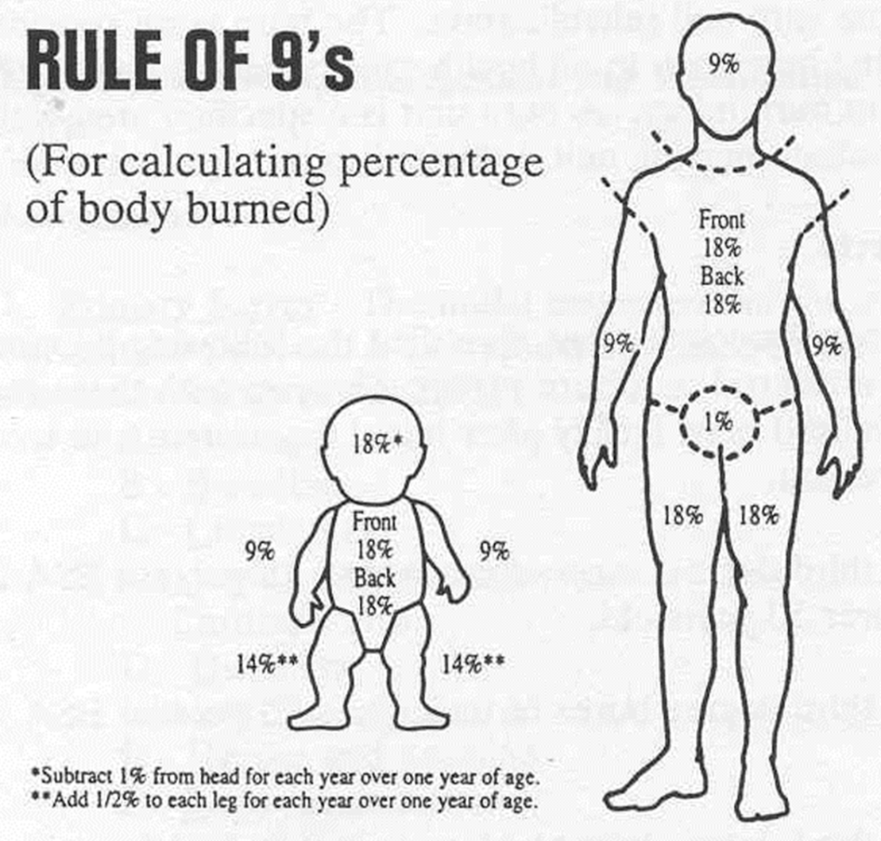
Burns con

Slide 21
Fluid calculaion
wt in kg x % burn x 2 - 4cc / kg / %
100 kg patient with 50% TBSA burn:
100 x 50 x 2 = 10,000cc = 10 liters RL
This is calculated for the first 24 hours post-burn.
Give half of this in first 8 hours.
Half of 10,000cc = 5000cc in 8 hrs = 400 cc / hr initially

Slide 22
Fluids
Aduls
3-4 ml (3 ml in superficial or partial-thickness burns, 4 ml in full-thickness burns or those with associated inhalation injury) of Hartmann's solution/kg body weight/% total body surface area.
Half of this calculated volume is given in the first eight hours and the other half is given over the following 16 hours.
Children:
Resuscitation fluid as above plus maintenance (0.45% saline with 5% dextrose) which should be titrated against nasogastric feeds or oral intake:
100 ml/kg for first 10 kg body weight plus 50 ml/kg for the next 10 kg body weight plus 20 ml/kg for each extra kg

Slide 23
Management Of Burns
Ensure adequate analgesia: strong opiates should be used. Prevent hypothermia.
Prompt irrigation with running cool tap water for 20 minutes provides appropriate cooling. Very cold water should be avoided (causes vasoconstriction and worsens tissue ischaemia and local oedema). Chemical burns may need longer periods of irrigation.
Dressings help to relieve pain and keep the area clean but avoid circumferential wrapping, as this can cause constriction.
All patients with facial burns or burns in an enclosed environment should be assessed by an anesthetist for early intubation.
For full-thickness circumferential burns, escharotomy may be required to avoid respiratory distress or reduced circulation to the limbs as a result of constriction.^{[6]}
Transfer to a burns centre or other appropriate care centre as indicated.

Slide 24
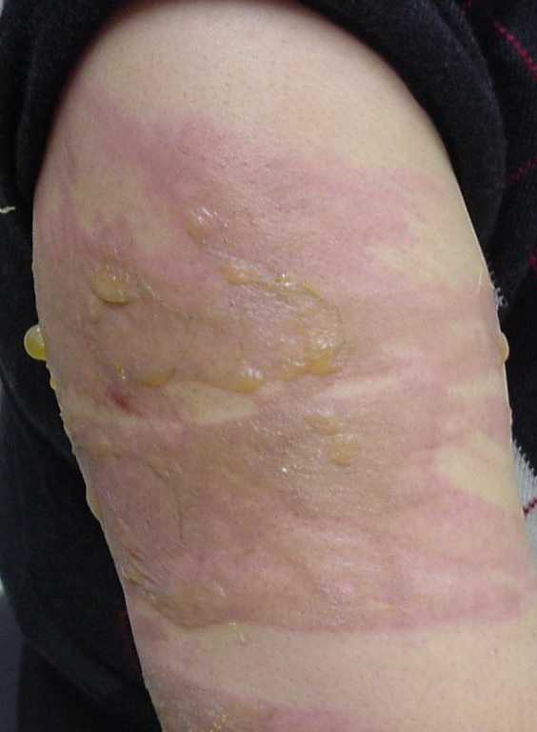
Small burns
Clean entire limb with
soap and water (also under nails).
Apply antibiotic cream
(no PO or IV antibiotic).
Dress limb in position of function, and elevate it.
No hurry to remove blisters unless infection occurs.
Give pain meds as needed (PO, IM, or IV)
Rinse daily in clean water; in shower is very practical.
Gently wipe off with clean gauze.

Slide 25
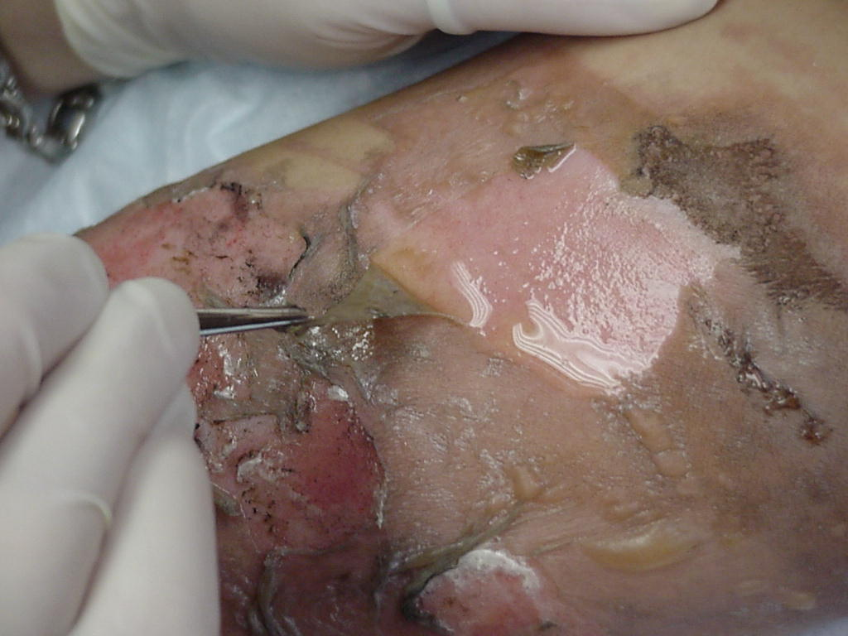
Debride blister using simple instruments

Slide 26
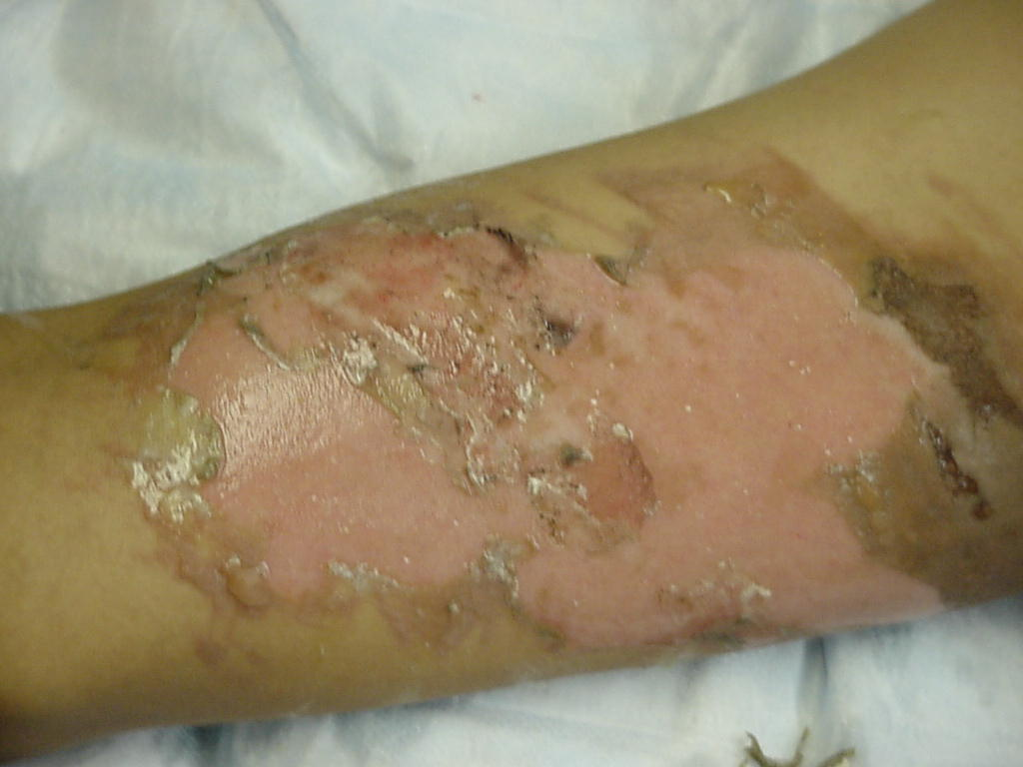
Afer debridemen

Slide 27
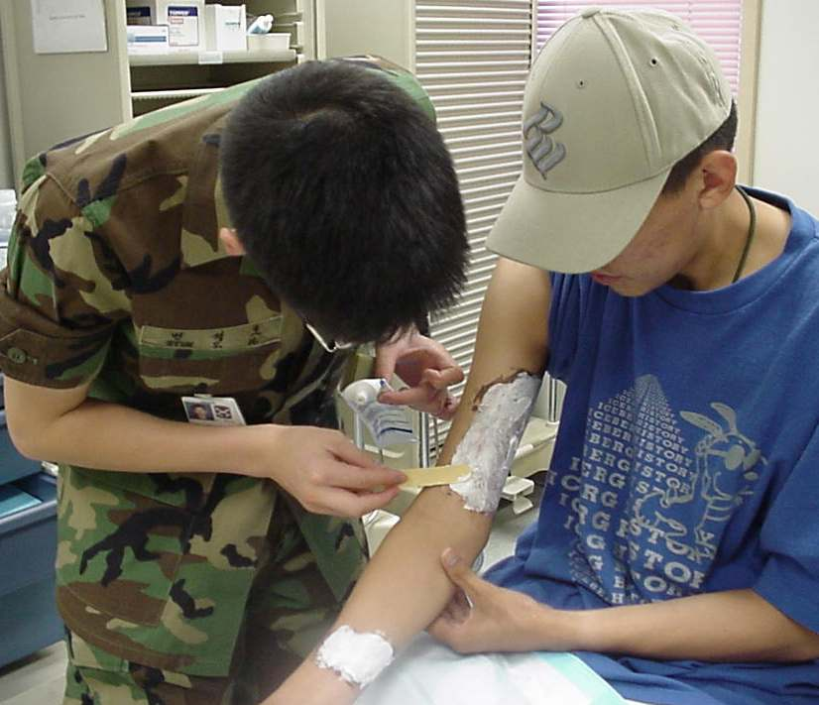
Silver sulfudiazine

Slide 28
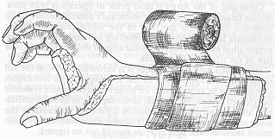
Dressing hands and legs
Allow use of the hands in dressings by day.
Splint in functional position by night.
Keep elevated to reduce swelling

Slide 29
poisoning
Ask for an containers found near casual
Milk or water is taken o dilute if It is alkaline or acidic. However, dilution is not attempted if the patient has acute airway edema or obstruction or if there is clinical evidence of esophageal, gastric, or intestinal burn or perforation.

Slide 30
poisoning
Gastric lavage
Not in unconscious patient unless intubated (risk aspiration)
Flexible tube is inserted through the nose into the stomach
Stomach contents are then suctioned via the tube
A solution of saline is injected into the tube
Recommended for up to 4hrs in Salicylate OD
Induced Vomiting
Not routinely recommended
Risk of aspiration

Slide 31
con
Activated charcoal
Adsorbs toxic substances or irritants, thus inhibiting GI absorption
Addition of sorbitol →laxative effect
Oral: 25-100 g as a single dose
repetitive doses useful to enhance the elimination of certain drugs (eg, theophylline, phenobarbital, carbamazepine, aspirin, sustained-release products)
not effective for cyanide, mineral acids, caustic alkalis, organic solvents, iron, ethanol, methanol poisoning, lithium

Slide 32
con
Renal elimination
Medication to stimulate urination or defecation may be given to try to flush the excess drug out of the body faster.
Forced alkaline diuresis
Infusion of large amount of NS+NAHCO3
Used to eliminate acidic drug that mainly excreted by the kidney eg salicylates
Serious fluid and electrolytes disturbance may occur
Need expert monitoring
Hemodialysis or haemoperfusion:
Reserved for severe poisoning
Drug should be dialyzable i.e. protein bound with low volume of distribution
may also be used temporarily or as long term if the kidneys are damaged due to the overdose.

Slide 33
con
Look up for poison and their anecdotes Throughout detoxification, the patient’s vital signs, CVP, and fluid and electrolyte balance are monitored closely. Hypotension and cardiac dysrhythmias are possible.

Slide 34
Anaphylactic shock
Definition:
Anaphylaxis is a serious, life-threatening allergic reaction. The most common anaphylactic reactions are to foods, insect stings, medications and latex.
Signs/Symptoms:
Tightness in chest or throat
Wheezing (whistling sound from airway)
Urticaria (hives)
BP down (vessels are dilating), pulse rate up (initially compensating)
Swelling of face, neck, tongue, lips, hands/feet
Anxiety, sense of impending doom
Itchy, watery eyes

Slide 35
Treatment:
Remove toxin (determine method of entry: skin, inhalation, sting)
Epinephrine (Epi Pen) if necessary
Constricts blood vessels: raises BP and pulse
Inhibits allergic reaction, makes breathing easier
Oxygen
Monitor vitals
Monitor for shock

Slide 36
Alcohol intoxication
Manifestation
drowsiness, incoordination, slurring of speech, sudden mood changes, aggression, belligerence, grandiosity,and uninhibited behavior.

Slide 37
mngt
approach the patient in a nonjudgmental manner, using a firm, consistent, accepting,and reasonable attitude.
Deermine sugar levels and give dexrose infusion.
Ensure ABC are oka and doa horough phsical exam.

Slide 38
Snake bite
having the victim lie down, removing constrictive items such as rings, providing warmth
cleansing the wound, covering the wound with a light sterile dressing
immobilizing the injured body part below the level of the heart.

Slide 39
con
ice, tourniquets, heparin, and corticosteroids are not used during the acute stage. Corticosteroids are contraindicated in the first 6 to 8 hours after the bite, because they may depress antibody production and hinder the action of antivenin.
Patient is observed for sometime then discharged.

Slide 40
wounds
Soft tissue injuries which range from minor ears to severe crush injuries.
Mngt
The wound is irrigated gently and copiously with sterile isotonic saline solution to remove surface dirt.
Antibacterial agents, such as povidone-iodine (Betadine) or hydrogen peroxide, should not be allowed to get deep into the wound without thorough rinsing. These agents are used only for the initial cleansing because they injure exposed and healthy tissue, resulting in further cell injury.

Slide 41
Non-adherent dressing is commonly applied to protect the wound.
Tetanus prophylaxis is administered as prescribed, based on the condition of the wound and the patient’s immunization status.

Slide 42
fractures
Partial or complete break of bone
Clinical manifestation
pain over or near a bone,
swelling (from blood, lymph, and exudate infiltrating the tissue).
ecchymosis, tenderness, and crepitation.
Numbness and tingling
deformity

Slide 43
management
it is an open fracture, cover the wound with a sterile dressing and secure it with a bandage. Apply pressure around the wound to control any bleeding.
Immobilise moving part
Pain management

Slide 44
Airway obstruction
If the airway is completely obstructed, permanent brain damage or death will occur within 3 to 5 minutes secondary to hypoxia.
Partial obstruction of the airway can lead to progressive hypoxia,hypercarbia, and respiratory and cardiac arrest.

Slide 45
causes
Aspiration of foreign bodies
anaphylaxis,
viral or bacterial infection,
trauma,
inhalation or chemical burns.

Slide 46
Clinical manifestation
choking, apprehensive appearance,
inspiratory and expiratory stridor, labored breathing,
use of accessory muscles (suprasternal and intercostal retraction),
flaring nostrils, increasing anxiety, restlessness, and confusion.
Cyanosis and loss of consciousness develop as hypoxia worsens.

Slide 47
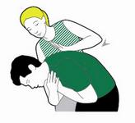
con
Cough It out
Slap it out

Slide 48
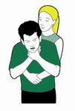
Squeeze It out(heimlich manouvre)

Slide 49
Keep airway patent using head tilt chin lift manouvre,jaw thrust,intubation or cricothyrodotomy.

Slide 50
Nose bleeding(epistaxis)
Causes
Frequent nose blowing
Allergic rhinitis
Hpertension
Bleeding disorders e.g haemophilia
Low platelet count

Slide 51
Emergency care
If someone is having a nose bleed, your priority is to control the bleeding and keep their airway open.
Get them to sit down (not lie down) as keeping the nose above the heart will reduce bleeding.
Get them to lean forward (not backwards), to make sure the blood drains out through their nose, rather than down their throat which could block their airway.
Nosebleeds what to do
Ask them to breathe through their mouth and pinch the soft part of the nose, taking a brief pause every ten minutes, until the bleeding stops.
Encourage them not to speak, swallow, cough, spit or sniff because this may break blood clots that may have started to form in the nose.

Slide 52
con
If It does not stop,you can give sylate or pack the nose with epinephrine or liquid paraffin.

Slide 53
fainting
Sudden brief loss of consciousness. It happens because for a moment there is not enough blood flowing to the brain.
Causes
Fatigue
Hypoglycemia
Emotional stress
Sanding for long
Some meds e.g antihypertensive
Forceful coughing

Slide 54
manifestation
Brief loss of responsiveness, often causing them to fall to the ground
A slow pulse
Pale cold skin and sweating
Management
Kneel down next to them and raise their legs, supporting their ankles on your shoulders to help blood flow back to the brain. Watch their face for signs that they’re recovering.

Slide 55
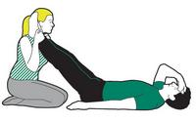
Make sure that they have plenty of fresh air – ask bystanders to move away and if you’re inside then ask someone to open a window.
Reassure the casualty and help them to sit up slowly.

Slide 56
seizures
Due to an abnormal brain electrical activity
Causes
Hereditary
Head injury
Brain tumor
Hypoglycemia in diabetic patients
Fever
Infection of brain

Slide 57
Clinical manifestaion
Sudden loss of responsiveness
Rigid body with an arching back
Noisy difficult breathing
Convulsions (jerky uncontrolled movements)
Loss of bladder and bowel control
Afterwards they may be confused, tired and fall into a deep sleep
NOTE.DO NOT PUT ANYTHING IN MOUTH

Slide 58
mng
Don’t restrain or move them.
Protect them from hurting themselves. Clear away any potentially dangerous objects, like hot drinks or sharp objects.
Make a note of the time when the seizure started and how long it lasts.
Protect their head by placing something soft underneath it, like a towel, and loosen any clothing around their neck.
Once the seizure has stopped, they may fall into a deep sleep – if they do, open their airway and check their breathing.
If they’re breathing, put them in the recovery position.

Slide 59
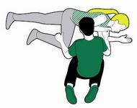
Recovery position

Slide 60
Near drowning
If someone has been rescued from drowning you need to check if they’re breathing or not.
If they aren't breathing, then you’ll need to give CPR (cardio pulmonary resuscitation) straight away.
What you need to do - Drowning
As soon as the casualty has been rescued from the water, check if they’re breathing.
If the person is unresponsive and not breathing, give them five initial rescue breaths before starting CPR.
Once you’ve done this, start CPR: 30 chest compressions, then two rescue breaths. Keep giving CPR until help arrives, the casualty regains responsiveness, or you’re too exhausted to keep going.
If you’re on your own, give CPR for one minute, before you call 999 or 112 for medical help.
If they start breathing again at any time, treat them for hypothermia by covering them with warm clothes and blankets. If they recover completely, replace their wet clothes with dry ones.

